Slide 1
Brute Force and Exhaustive Search
Chapter 3
Dr. Maram Bani Younes

Slide 2
Contents
Brute Force and Exhaustive Search
Selection Sort
Bubble Sort
Insertion Sort
Sequential Search
String Matching
Depth-First Search (DFS)
Breadth-First Search (BFS)

Slide 3
Brute Force and Exhaustive Search
Brute force is a straightforward approach to solving a problem, usually directly based on the problem statement and definitions of the concepts involved.
The “force” implied by the strategy’s definition is that of a computer and not that of one’s intellect. “Just do it!” would be another way to describe the prescription of the brute-force approach. And often, the brute-force strategy is indeed the one that is easiest to apply.

Slide 4
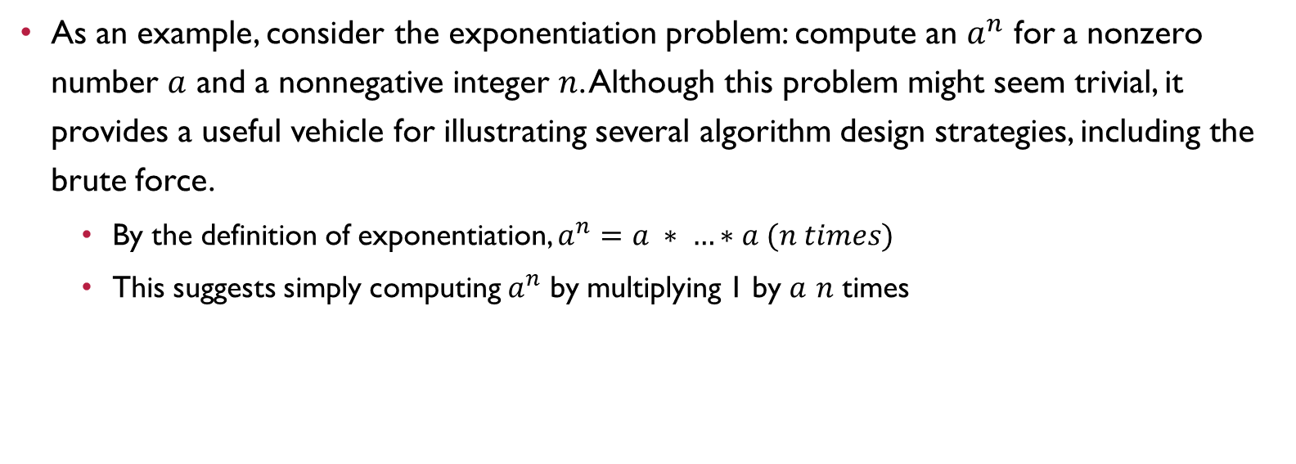
Example
As an example, consider the exponentiation problem: compute an $a^{n}$ for a nonzero number $a$ and a nonnegative integer $n$. Although this problem might seem trivial, it provides a useful vehicle for illustrating several algorithm design strategies, including the brute force.
  By the definition of exponentiation, $a^{n}=a ∗ …∗a (n times)$
  This suggests simply computing $a^{n}$ by multiplying 1 by $a$ $n$ times

Slide 5
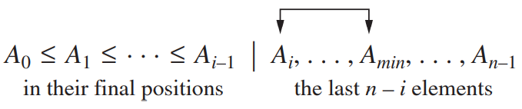
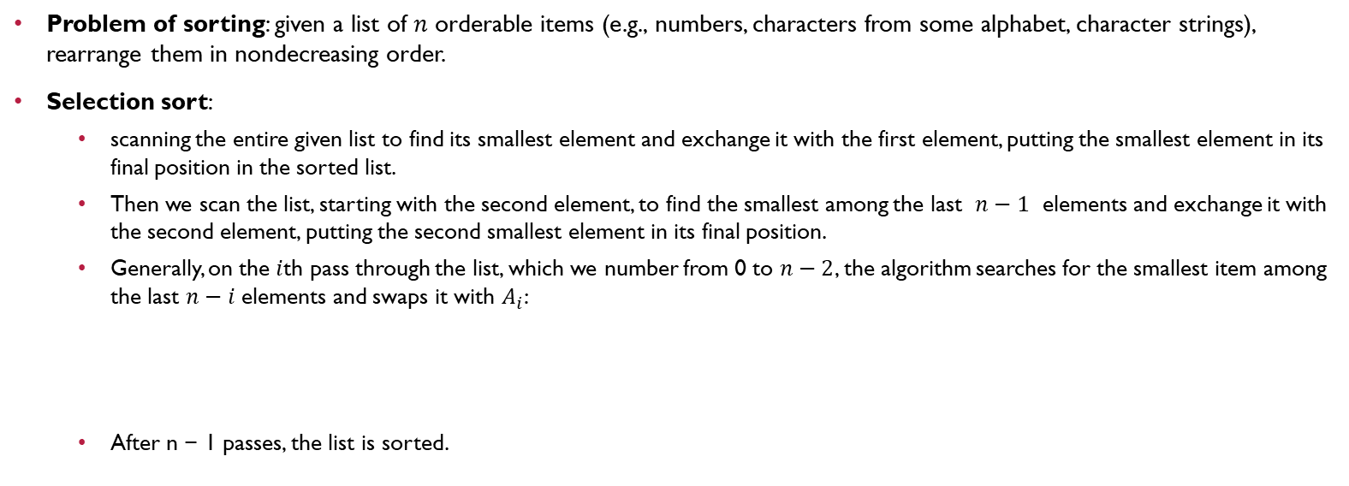
Selection Sort
Problem of sorting: given a list of $n$ orderable items (e.g., numbers, characters from some alphabet, character strings), rearrange them in nondecreasing order.
Selection sort:
  scanning the entire given list to find its smallest element and exchange it with the first element, putting the smallest element in its final position in the sorted list.
  Then we scan the list, starting with the second element, to find the smallest among the last $n−1$ elements and exchange it with the second element, putting the second smallest element in its final position.
  Generally, on the $i$th pass through the list, which we number from 0 to $n−2$, the algorithm searches for the smallest item among the last $n−i$ elements and swaps it with $A_{i}$:
  After n − 1 passes, the list is sorted.

Slide 6
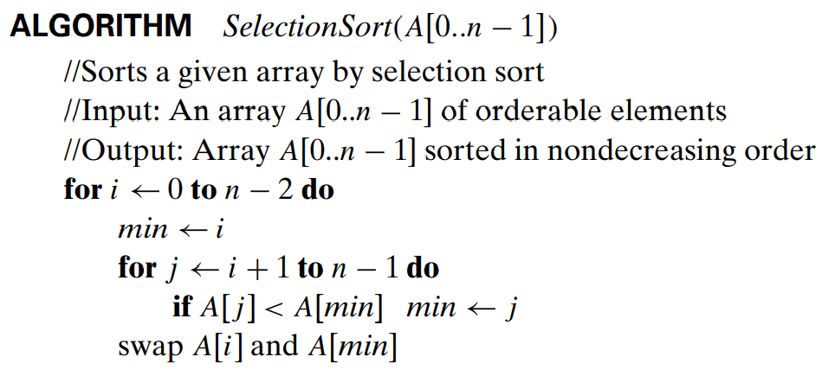
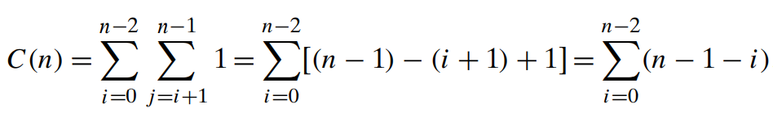
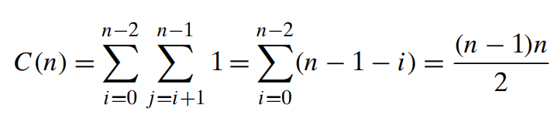
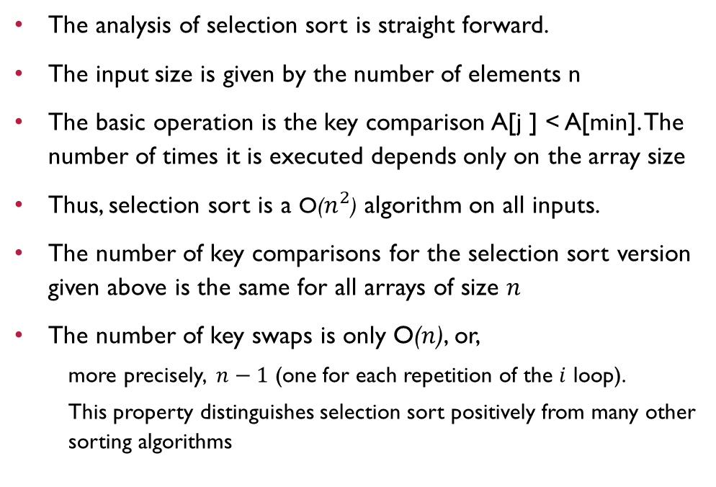
Selection Sort
The analysis of selection sort is straight forward.
The input size is given by the number of elements n
The basic operation is the key comparison A[j ] < A[min]. The number of times it is executed depends only on the array size
Thus, selection sort is a O($n^{2}$) algorithm on all inputs.
The number of key comparisons for the selection sort version given above is the same for all arrays of size $n$
The number of key swaps is only O($n$), or,
  more precisely, $n−1$ (one for each repetition of the $i$ loop).
  This property distinguishes selection sort positively from many other sorting algorithms

Slide 7
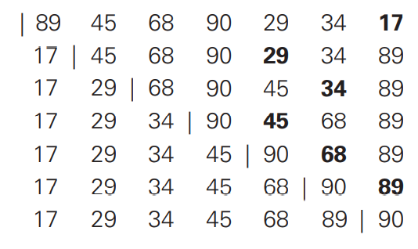
Selection Sort
Example of sorting with selection sort.
Each line corresponds to one iteration of the algorithm, i.e., a pass through the list’s tail to the right of the vertical bar; an element in bold indicates the smallest element found.
Elements to the left of the vertical bar are in their final positions and are not considered in this and subsequent iterations.

Slide 8
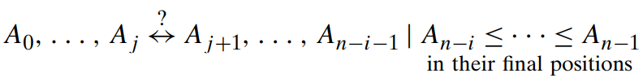
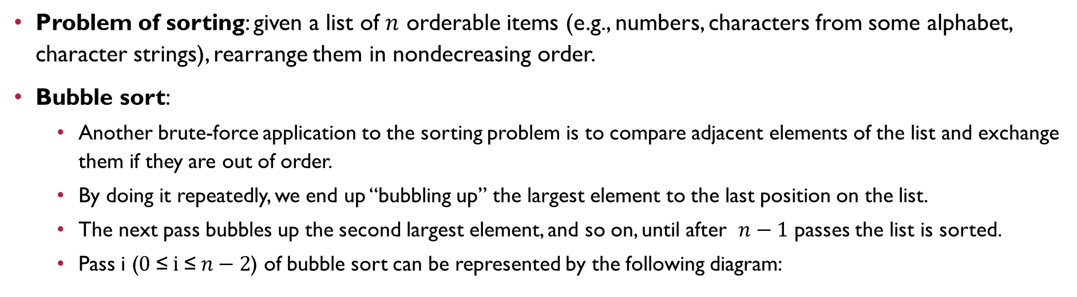
Bubble Sort
Problem of sorting: given a list of $n$ orderable items (e.g., numbers, characters from some alphabet, character strings), rearrange them in nondecreasing order.
Bubble sort:
  Another brute-force application to the sorting problem is to compare adjacent elements of the list and exchange them if they are out of order.
  By doing it repeatedly, we end up “bubbling up” the largest element to the last position on the list.
  The next pass bubbles up the second largest element, and so on, until after $n−1$ passes the list is sorted.
  Pass i ($0 \text{≤} i \text{≤} n−2$) of bubble sort can be represented by the following diagram:

Slide 9
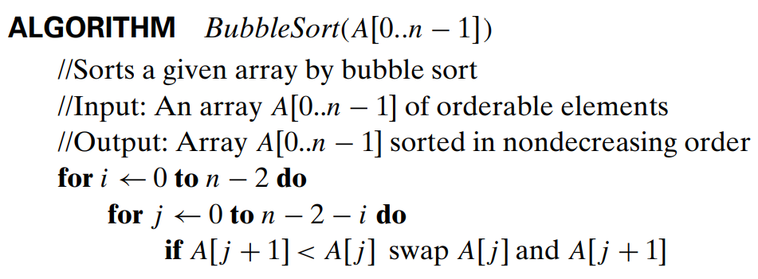
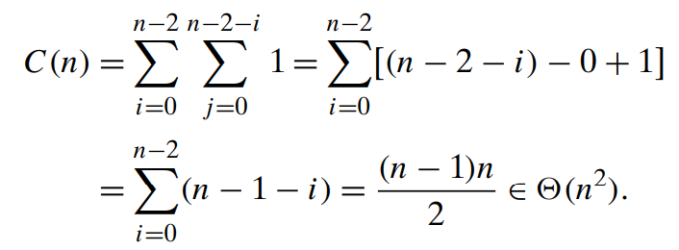


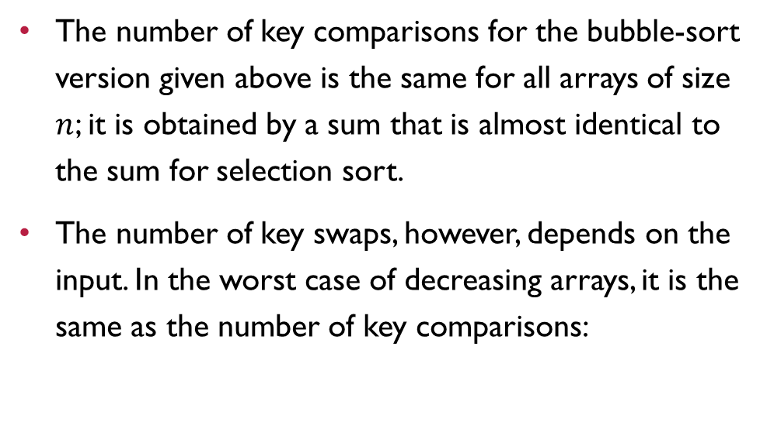
Bubble Sort
The number of key comparisons for the bubble-sort version given above is the same for all arrays of size $n$; it is obtained by a sum that is almost identical to the sum for selection sort.
The number of key swaps, however, depends on the input. In the worst case of decreasing arrays, it is the same as the number of key comparisons:

Slide 10
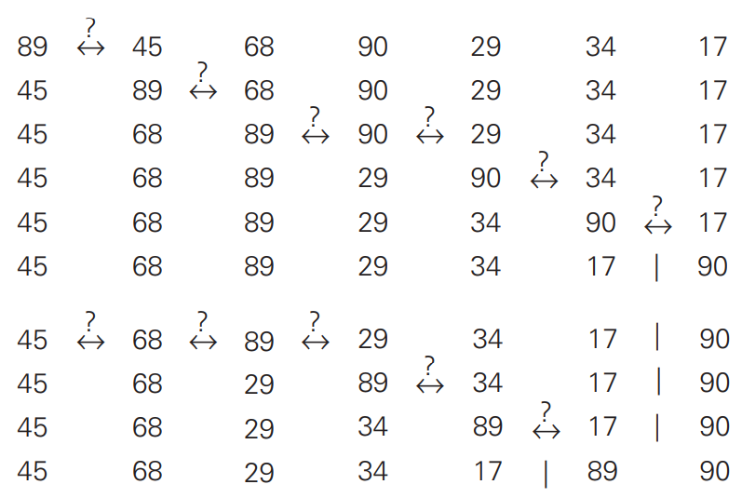
Bubble Sort
First two passes of bubble sort on the list 89, 45, 68, 90, 29, 34, 17.
A new line is shown after a swap of two elements is done.
The elements to the right of the vertical bar are in their final positions and are not considered in subsequent iterations of the algorithm.

Slide 11
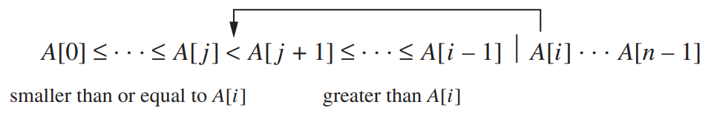
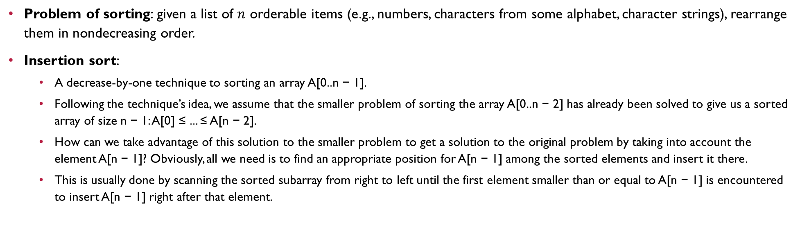
Insertion Sort
Problem of sorting: given a list of $n$ orderable items (e.g., numbers, characters from some alphabet, character strings), rearrange them in nondecreasing order.
Insertion sort:
  A decrease-by-one technique to sorting an array A[0..n − 1].
  Following the technique’s idea, we assume that the smaller problem of sorting the array A[0..n − 2] has already been solved to give us a sorted array of size n − 1: A[0] ≤ ... ≤ A[n − 2].
  How can we take advantage of this solution to the smaller problem to get a solution to the original problem by taking into account the element A[n − 1]? Obviously, all we need is to find an appropriate position for A[n − 1] among the sorted elements and insert it there.
  This is usually done by scanning the sorted subarray from right to left until the first element smaller than or equal to A[n − 1] is encountered to insert A[n − 1] right after that element.

Slide 12
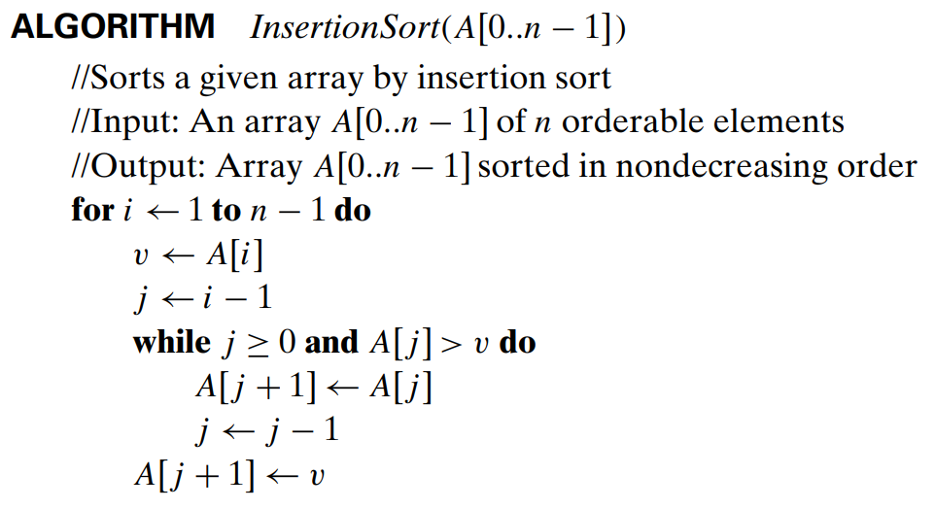
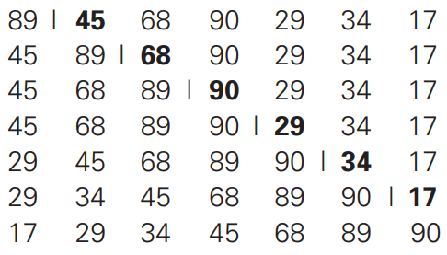
Insertion Sort
starting with A[1] and ending with A[n − 1], A[i]is inserted in its appropriate place among the first i elements of the array that have been already sorted
The basic operation of the algorithm is the key comparison A[j ]> v. (Why not j ≥ 0? Because it is almost certainly faster than the former in an actual computer implementation. Moreover, it is not germane to the algorithm: a better implementation with a sentinel eliminates it altogether.)

Slide 13
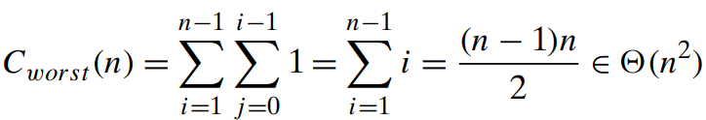
Insertion Sort
  The number of key comparisons in this algorithm obviously depends on the nature of the input. In the worst case, A[j ] > v is executed the largest number of times, i.e., for every j = i − 1,..., 0. Since v = A[i], it happens if and only if A[j ] > A[i] for j = i − 1,..., 0. (Note that we are using the fact that on the ith iteration of insertion sort all the elements preceding A[i] are the first i elements in the input, albeit in the sorted order.)
  Thus, for the worst-case input, we get A[0]> A[1] (for i = 1), A[1] > A[2] (for i = 2),...,A[n − 2] > A[n − 1] (for i = n − 1). In other words, the worst-case input is an array of strictly decreasing values. The number of key comparisons for such an input is
  Thus, in the worst case, insertion sort makes exactly the same number of comparisons as selection sort

Slide 14
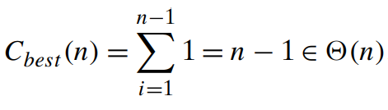
Insertion Sort
  In the best case, the comparison A[j ] > v is executed only once on every iteration of the outer loop. It happens if and only if A[i − 1] ≤ A[i] for every i = 1,...,n − 1, i.e., if the input array is already sorted in nondecreasing order.
  Thus, for sorted arrays, the number of key comparisons is
  This very good performance in the best case of sorted arrays is not very useful by itself, because we cannot expect such convenient inputs. However, almost-sorted files do arise in a variety of applications, and insertion sort preserves its excellent performance on such inputs.

Slide 15

Insertion Sort
  A rigorous analysis of the algorithm’s average-case efficiency is based on investigating the number of element pairs that are out of order.
  It shows that on randomly ordered arrays, insertion sort makes on average half as many comparisons as on decreasing arrays, i.e.,
  This twice-as-fast average-case performance coupled with an excellent efficiency on almost-sorted arrays makes insertion sort stand out among its principal competitors among elementary sorting algorithms, selection sort and bubble sort.

Slide 16
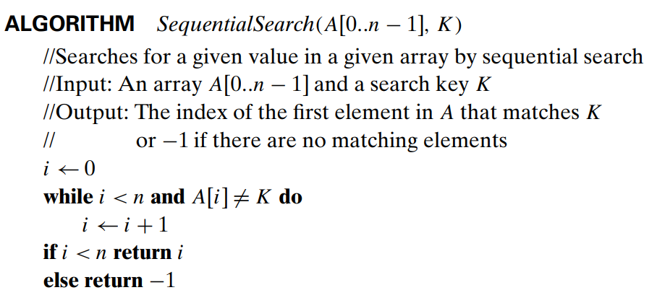
Sequential Search
The algorithm simply compares successive elements of a given list with a given search key until either a match is encountered (successful search) or the list is exhausted without finding a match (unsuccessful search).
A simple extra trick is often employed in implementing sequential search: if we append the search key to the end of the list, the search for the key will have to be successful, and therefore we can eliminate the end of list check altogether.

Slide 17
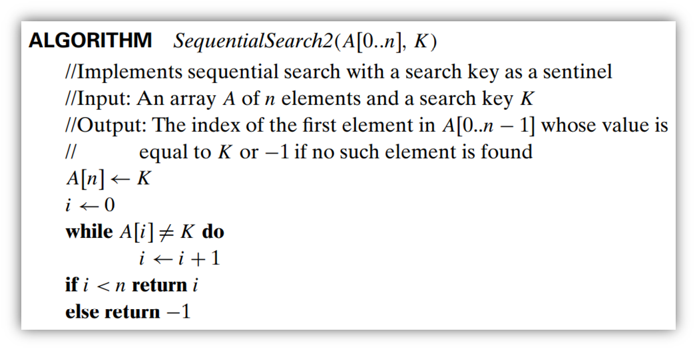
Sequential Search
Another straightforward improvement can be incorporated in sequential search if a given list is known to be sorted: searching in such a list can be stopped as soon as an element greater than or equal to the search key is encountered.

Slide 18
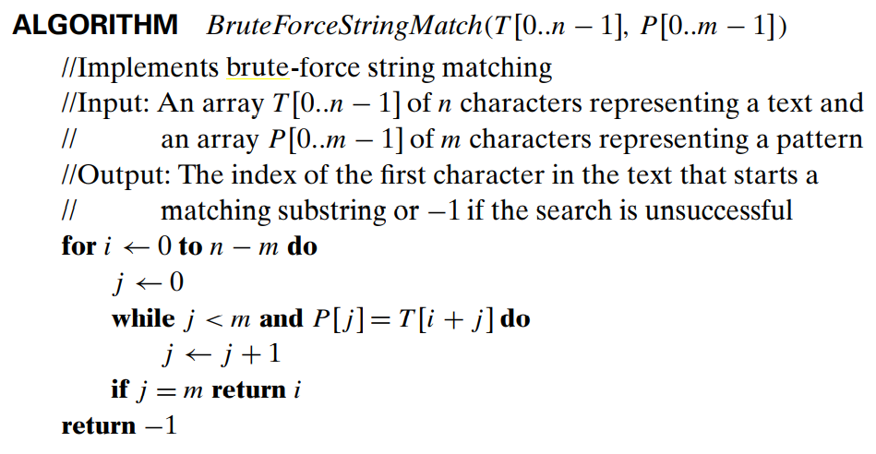
String Matching
Problem : given a string of n characters called the text and a string of m characters (m ≤ n) called the pattern, find a substring of the text that matches the pattern.
Brute-force Solution: align the pattern against the first m characters of the text and start matching the corresponding pairs of characters from left to right until either all the m pairs of the characters match (then the algorithm can stop) or a mismatching pair is encountered. In the latter case, shift the pattern one position to the right and resume the character comparisons, starting again with the first character of the pattern and its counterpart in the text.

Slide 19
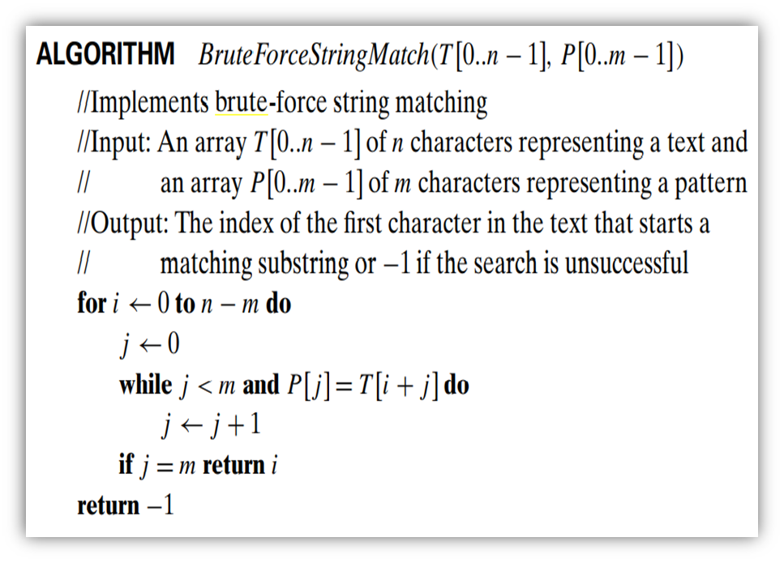
String Matching
Note that the last position in the text that can still be a beginning of a matching substring is n − m (provided the text positions are indexed from 0 to n − 1). Beyond that position, there are not enough characters to match the entire pattern; hence, the algorithm need not make any comparisons there.

Slide 20
Depth-First Search (DFS)
Depth-first search starts a graph’s traversal at an arbitrary vertex by marking it as visited.
On each iteration, the algorithm proceeds to an unvisited vertex that is adjacent to the one it is currently in. (If there are several such vertices, a tie can be resolved by the alphabetical order of the vertices.)
This process continues until a dead end—a vertex with no adjacent unvisited vertices— is encountered.
At a dead end, the algorithm backs up one edge to the vertex it came from and tries to continue visiting unvisited vertices from there.
The algorithm eventually halts after backing up to the starting vertex, with the latter being a dead end. By then, all the vertices in the same connected component as the starting vertex have been visited.
If unvisited vertices still remain, the depth-first search must be restarted at any one of them.

Slide 21
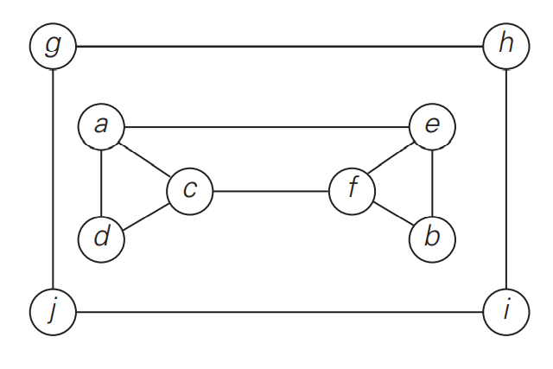
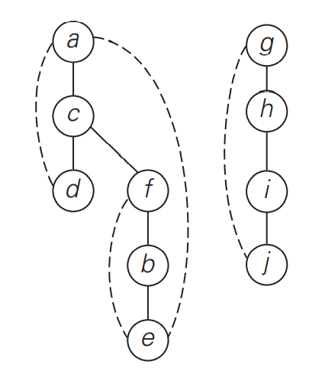
Depth-First Search (DFS)
It is convenient to use a stack to trace the operation of depth-first search. We push a vertex onto the stack when the vertex is reached for the first time, and we pop a vertex off the stack when it becomes a dead end.
It is also very useful to accompany a depth-first search traversal by constructing the so-called depth-first search forest.
The starting vertex of the traversal serves as the root of the first tree in such a forest. Whenever a new unvisited vertex is reached for the first time, it is attached as a child to the vertex from which it is being reached. Such an edge is called a tree edge because the set of all such edges forms a forest.
The algorithm may also encounter an edge leading to a previously visited vertex other than its immediate predecessor (i.e., its parent in the tree). Such an edge is called a back edge because it connects a vertex to its ancestor, other than the parent, in the depth-first search forest.
a, c, d, f, b, e, g, h, i, j

Slide 22
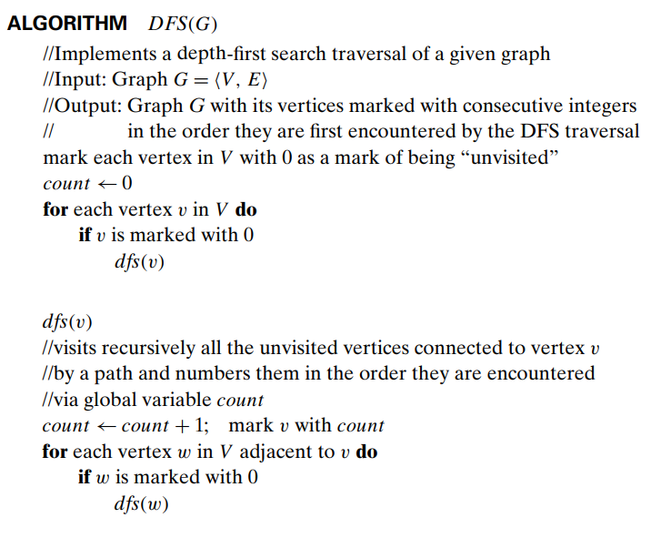
Depth-First Search (DFS)
The brevity of the DFS pseudocode and the ease with which it can be performed by hand may create a wrong impression about the level of sophistication of this algorithm.
To appreciate its true power and depth, you should trace the algorithm’s action by looking not at a graph’s diagram but at its adjacency matrix or adjacency lists.

Slide 23
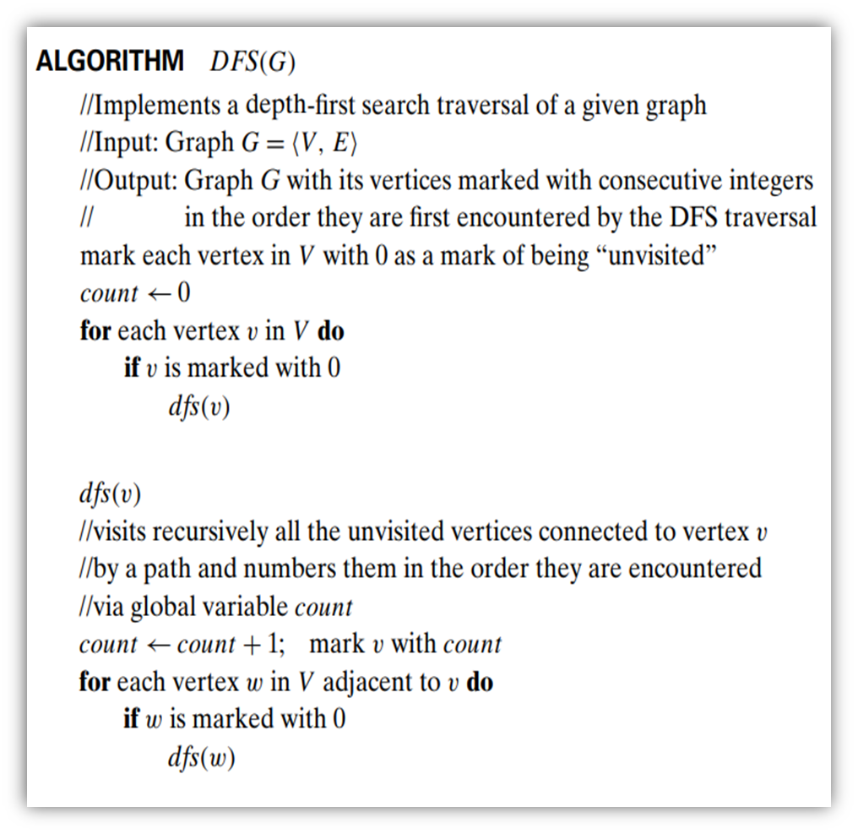
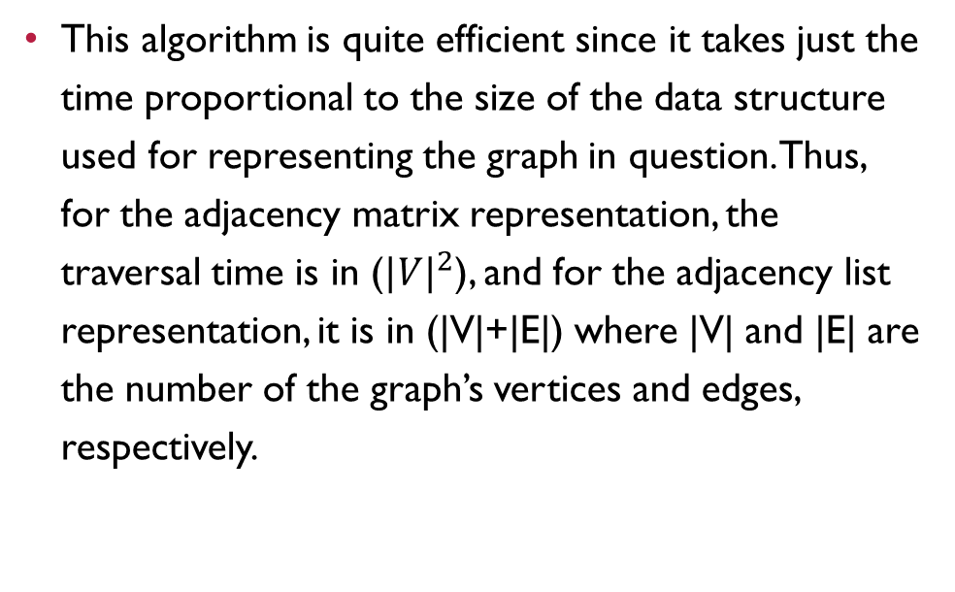
Depth-First Search (DFS)
This algorithm is quite efficient since it takes just the time proportional to the size of the data structure used for representing the graph in question. Thus, for the adjacency matrix representation, the traversal time is in (${|V|}^{2}$), and for the adjacency list representation, it is in (|V|+|E|) where |V| and |E| are the number of the graph’s vertices and edges, respectively.

Slide 24
Breadth-First Search (BFS)
If depth-first search is a traversal for the brave (the algorithm goes as far from “home” as it can), breadth-first search is a traversal for the cautious.
It proceeds in a concentric manner by visiting first all the vertices that are adjacent to a starting vertex, then all unvisited vertices two edges apart from it, and so on, until all the vertices in the same connected component as the starting vertex are visited.
If there still remain unvisited vertices, the algorithm has to be restarted at an arbitrary vertex of another connected component of the graph.

Slide 25
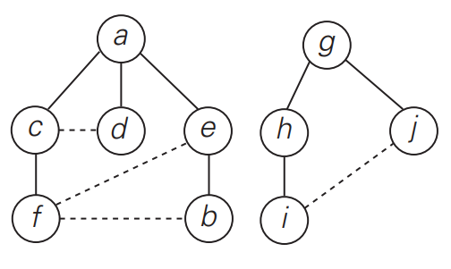
Breadth-First Search (BFS)
It is convenient to use a queue to trace the operation of breadth-first search. The queue is initialized with the traversal’s starting vertex, which is marked as visited. On each iteration, the algorithm identifies all unvisited vertices that are adjacent to the front vertex, marks them as visited, and adds them to the queue; after that, the front vertex is removed from the queue.
Similarly to a DFS traversal, it is useful to accompany a BFS traversal by constructing the so-called breadth-first search forest.
The traversal’s starting vertex serves as the root of the first tree in such a forest. Whenever a new unvisited vertex is reached for the first time, the vertex is attached as a child to the vertex it is being reached from with an edge called a tree edge.
If an edge leading to a previously visited vertex other than its immediate predecessor (i.e., its parent in the tree) is encountered, the edge is noted as a cross edge.
a, c, d, e, f, b, g, h, j, i

Slide 26
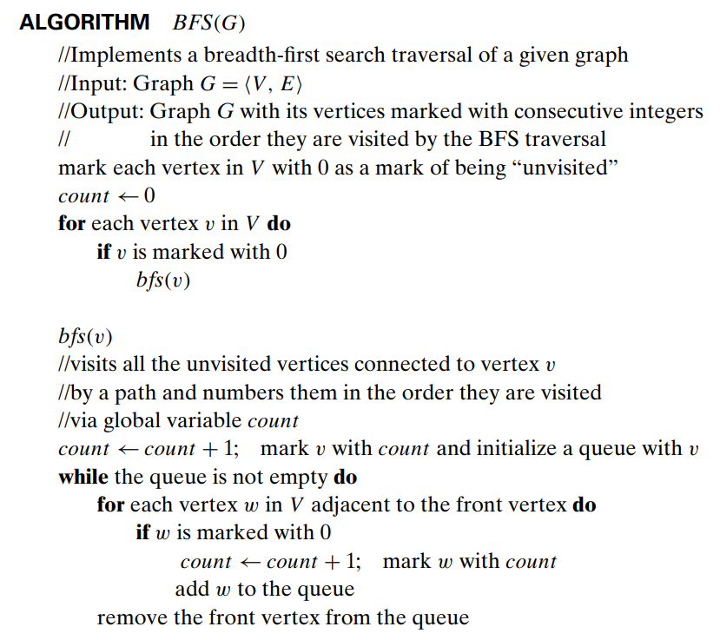
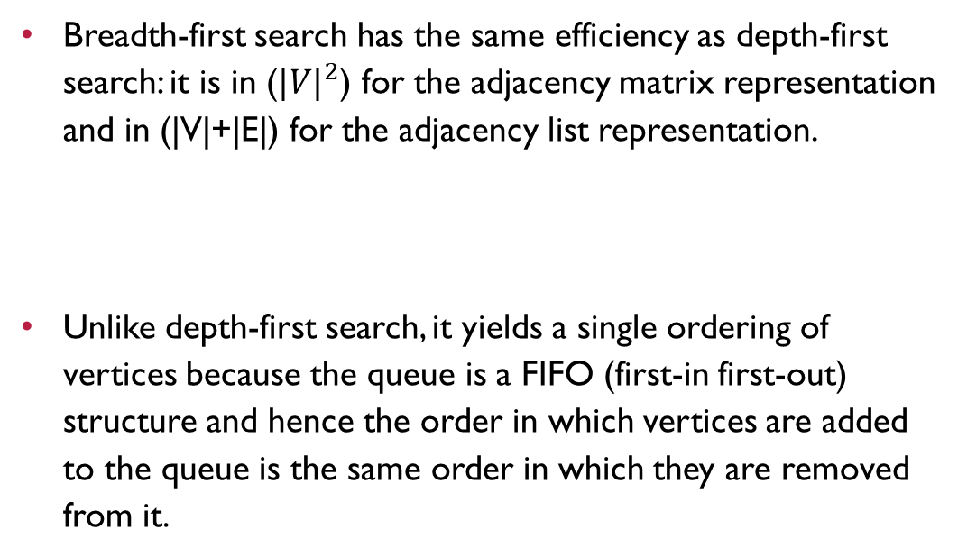
Breadth-First Search (BFS)
Breadth-first search has the same efficiency as depth-first search: it is in (${|V|}^{2}$) for the adjacency matrix representation and in (|V|+|E|) for the adjacency list representation.
Unlike depth-first search, it yields a single ordering of vertices because the queue is a FIFO (first-in first-out) structure and hence the order in which vertices are added to the queue is the same order in which they are removed from it.

